Slide 1
Music Genre Classification
Submited to : Dr. Narayan Chaturvedi
by: Pranshu Sati

Slide 2
Approach used
I have used the K Nearest Neighbour(KNN) Approach as it can make predictions more accurately and is also very simple to impliment.
What is K Nearest Neighbour(KNN) Algorithm?
It is one of the most simple Supervised machine learning algorithm for classification as well as regression which uses proximity to make classifications or predictions about the grouping of an individual data point. While it can be used for either regression or classification problems, it is typically used as a classification algorithm, working off the assumption that similar points can be found near one another

Slide 3
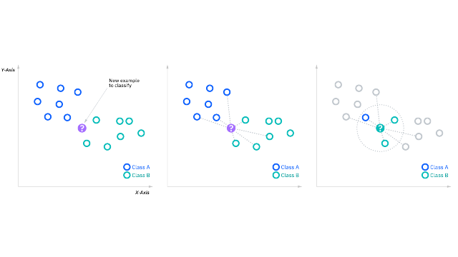
How Dose K Nearest Neighbour(KNN) Work
It transforms the features that are extracted into a point on the graph,
and works on the assumpition that similar values or points that are close to eachother belong to the same class and for predicting a class label it plots the value of the the unknown input on the graph and calculates the Euclidian distance from the other classes. The classes having the smallest distance from the given point is selected as the prediction class.

Slide 4
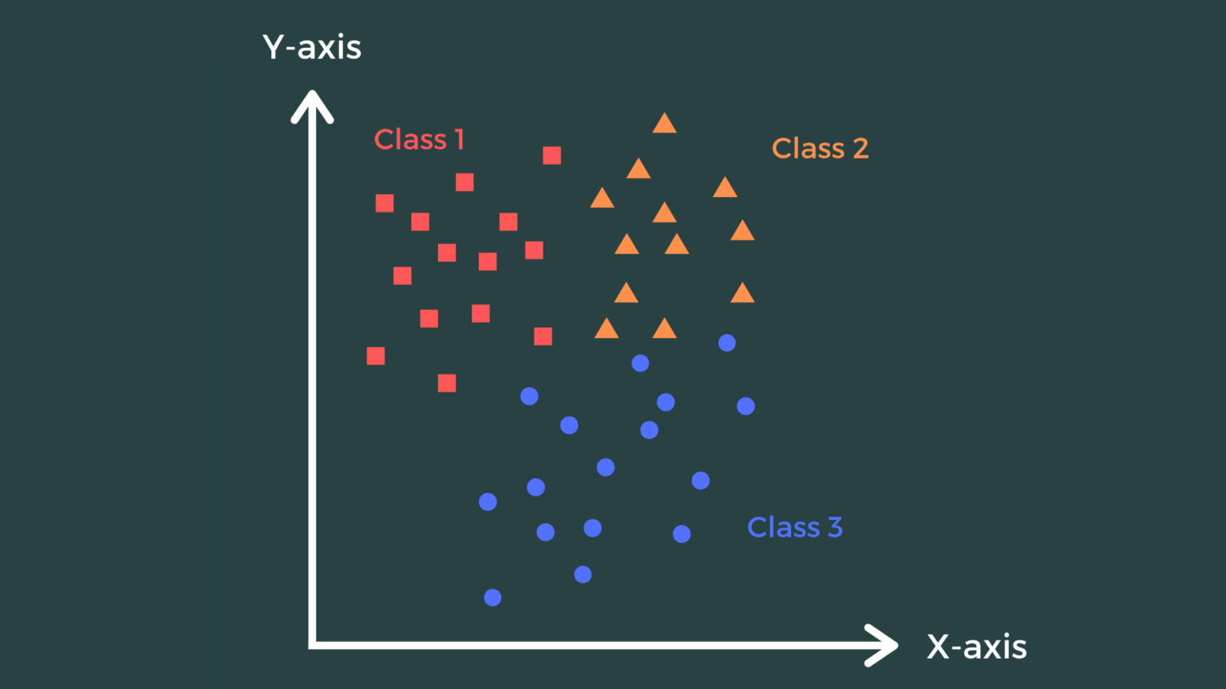
Knn Graph for Multiclass Labels

Slide 5
Advantages and disadvantages of the KNN algorithm
Advantages
- Easy to implement: Given the algorithm’s simplicity and accuracy, it is one of the first classifiers that a new data scientist will learn.
- Adapts easily: As new training samples are added, the algorithm adjusts to account for any new data since all training data is stored into memory.
- Few hyperparameters: KNN only requires a k value and a distance metric, which is low when compared to other machine learning algorithms.
Disadvantages
- Does not scale well: Since KNN is a lazy algorithm, it takes up more memory and data storage compared to other classifiers. This can be costly from both a time and money perspective. More memory and storage will drive up business expenses and more data can take longer to compute. While different data structures, such as Ball-Tree, have been created to address the computational inefficiencies, a different classifier may be ideal depending on the business problem.
- Curse of dimensionality: The KNN algorithm tends to fall victim to the curse of dimensionality, which means that it doesn’t perform well with high-dimensional data inputs. This is sometimes also referred to as the peaking phenomenon (PDF, 340 MB) (link resides outside of ibm.com), where after the algorithm attains the optimal number of features, additional features increases the amount of classification errors, especially when the sample size is smaller.
- Prone to overfitting: Due to the “curse of dimensionality”, KNN is also more prone to overfitting. While feature selection and dimensionality reduction techniques are leveraged to prevent this from occurring, the value of k can also impact the model’s behavior. Lower values of k can overfit the data, whereas higher values of k tend to “smooth out” the prediction values since it is averaging the values over a greater area, or neighborhood. However, if the value of k is too high, then it can underfit the data.

Slide 6
Why Did I use it for Music Genre Classification
Easy to impliment
The KNN algorithm, when implemented in music genre classification, looks at similar songs and assumes that they belong to the same category because they seem to be near to each other. Among various other techniques this is by far the most logical, the best results have been procured out of this technique.
The KNN algorithm interprets data in a manner such that when the new data is fed, the machine automatically recognizes it and categorizes it as per the similarity of features.
Also particular set of traits of a particular music genre make it different from others which, in turn, helps machines to readily classify new data inputs.

